Slide 1


个人介绍
李子南
12011517
计算机科学与工程系

Slide 2
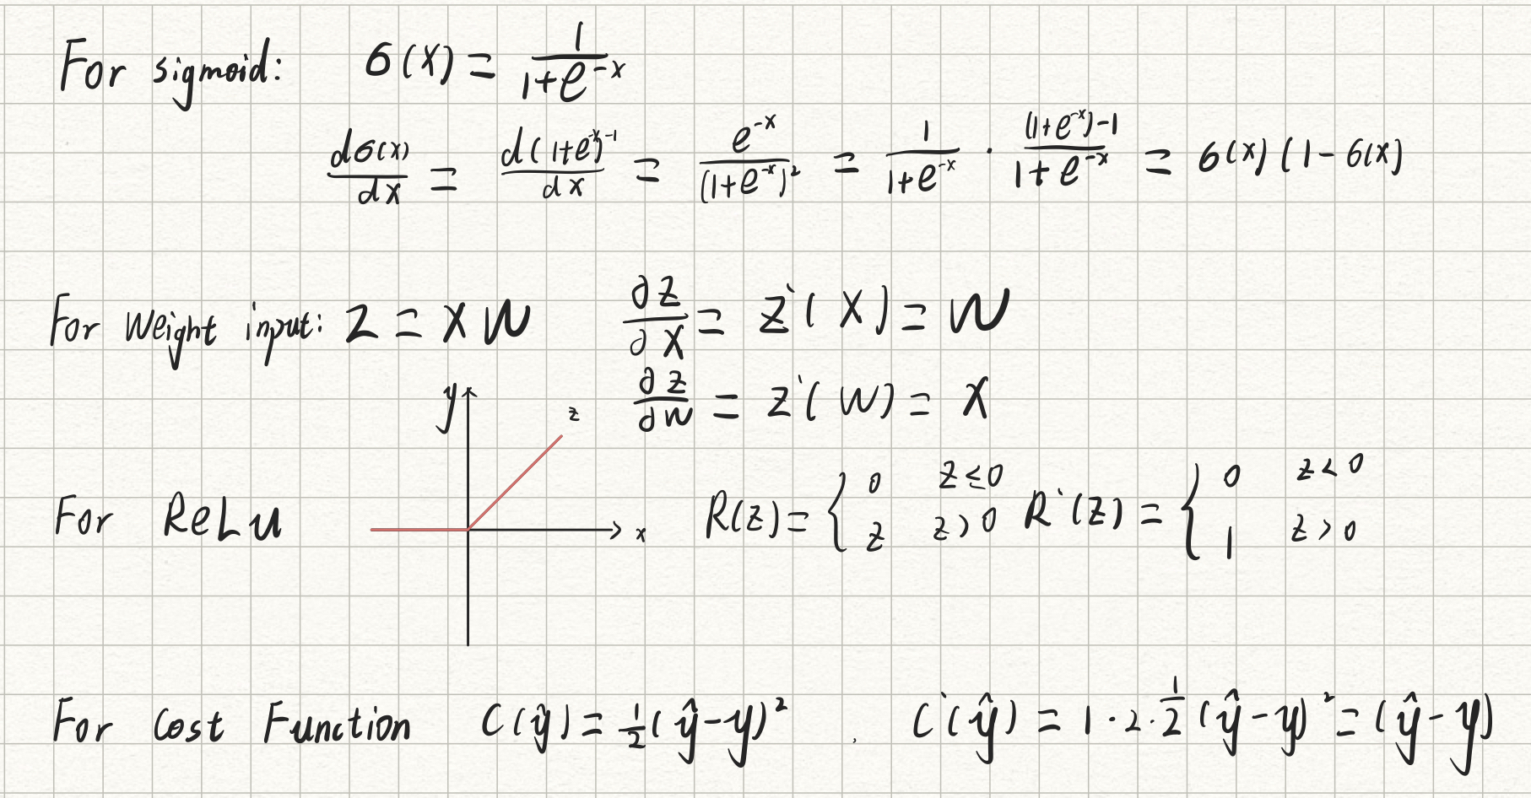
Homework 8: Prove the derivative formula (in yellow box) of Sigmoid and ReLU Transfer Functions

